Slide 1
Điều khiển nhiệt độ ứng dụng cho lò ấp trứng.
Ngô Minh Khánh – 18020698
Đặng Trung Hiếu – 18020498

Slide 2
Nội dung
I. Mở đầu
II. Sơ lược hệ thống
III. Chương trình.
IV. Tổng kết & đánh giá

Slide 3
I. Mở đầu.
Lò ấp trứng là một trong những phát minh giúp cung cấp tính năng đặc biệt cho người nông nông dân. Hệ thống sẽ tự động kiểm soát nhiệt độ của lò ấp cho các loại trứng. Chức năng của máy ấp trứng làm giảm công việc đồng thời tăng hiệu năng và tỷ lệ nở cao.
Các yêu cầu chức năng:
Đo đạc nhiệt độ.
Điều chỉnh nhiệt độ cài đặt.
Hiện thị nhiệt độ cài đặt và nhiệt độ hiện tại.
Điều chỉnh thiết bị gia nhiệt dùng thuật toán PID.
Tính năng tản nhiệt.

Slide 4
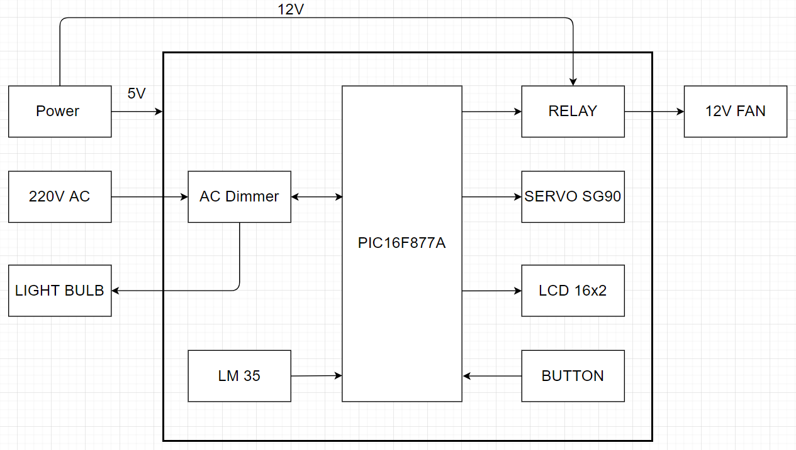
II. Sơ lược hệ thống.
1. Sơ đồ khối thành phần hệ thống.

Slide 5
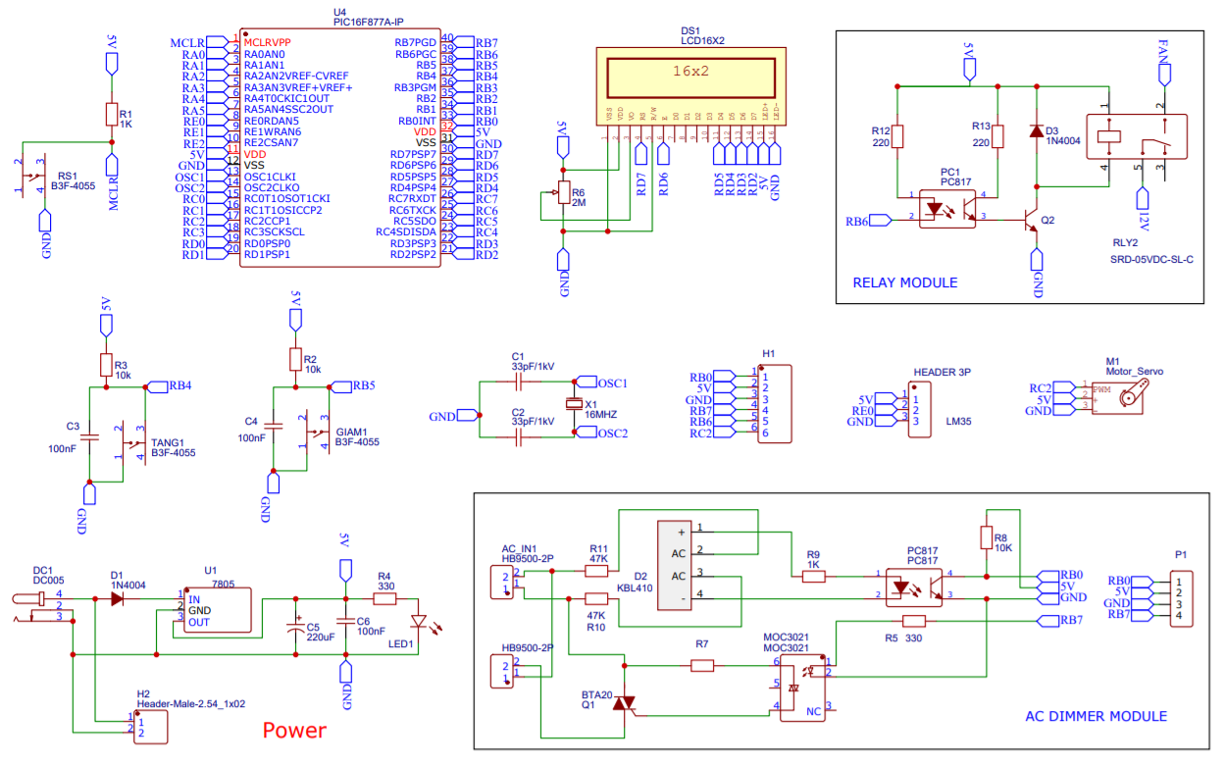
II. Sơ lược hệ thống.
2. Mạch nguyên lý.

Slide 6
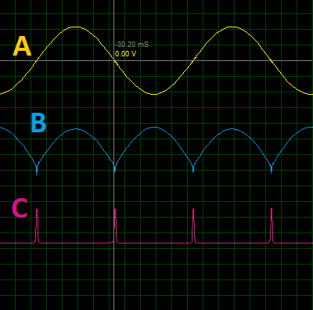
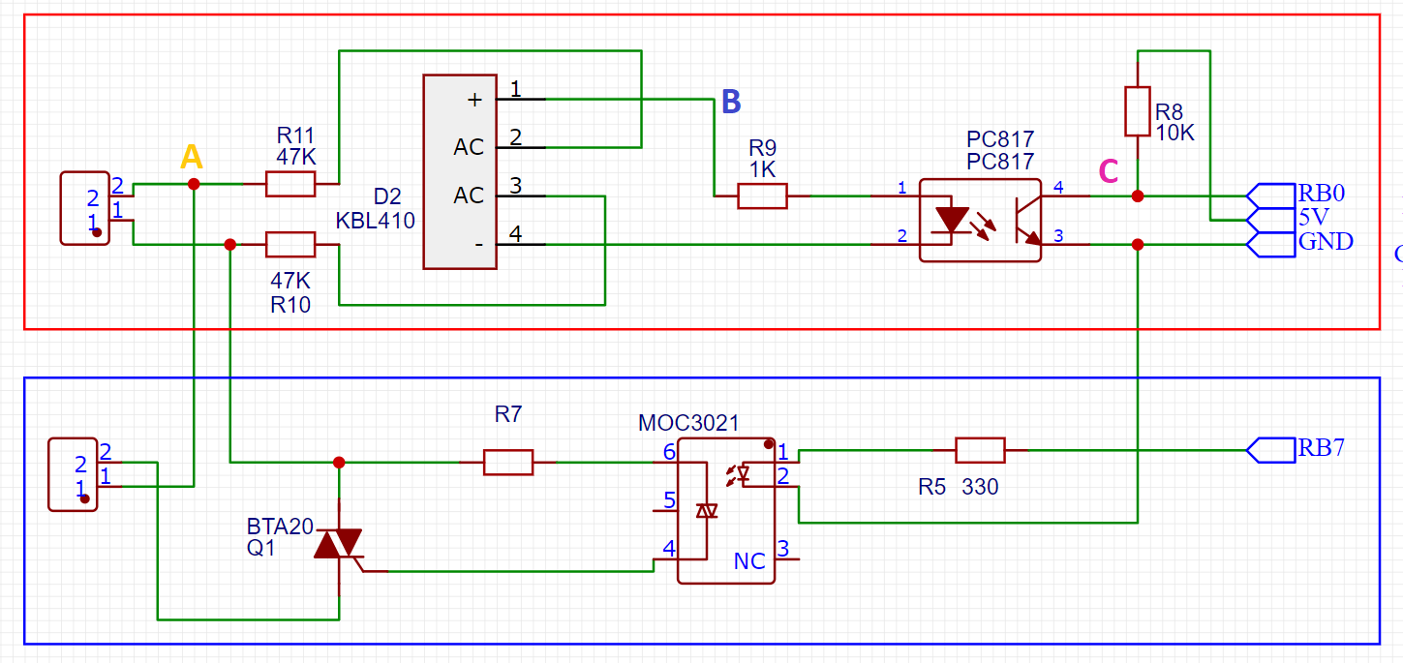
II. Sơ lược hệ thống.
4. AC Dimmer.
a, Mạch phát hiện điểm 0 (Khung đỏ).
AC_IN
LOAD
A: Điện áp xoay chiều 220V.
Dạng sóng là xung kích để VĐK nhận biết
được điểm 0 trong nguồn điện ở đâu, đưa
ra tín hiệu ổn định chính xác.
B: Điện áp sau khi qua cầu diode KBL410.
C: Xung báo hiệu điểm 0.

Slide 7
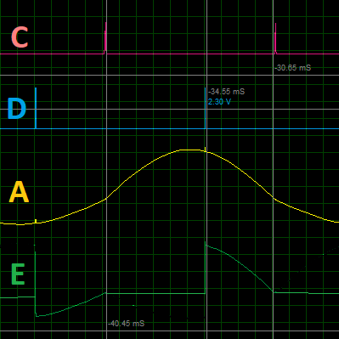

II. Sơ lược hệ thống.
4. AC Dimmer.
b, Mạch kích Thyristor (Khung xanh).
P
AC_IN
t
LOAD
A: Điện áp xoay chiều 220V.
Khi VĐK kích 1 ra MOC3021, diode quang trong Opto kích cho Triac bên trong thông, dẫn điện áp kích và chân G của Thyristor BTA20, điện áp 220V đi đến đèn.
C: Xung báo hiệu điểm 0.
D: Điện áp kích Triac.
E: Điện xoay chiều dùng điều khiển thiết bị.

Slide 8
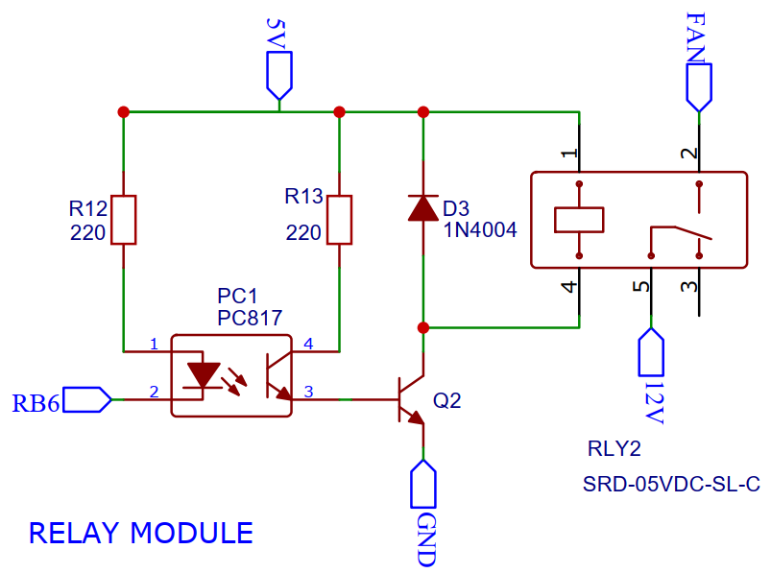
II. Sơ lược hệ thống.
5. Relay.
RB6 = 0, Q2 thông, dòng điện qua cuộn dây, gây ra lực từ hút chân COM từ NC chuyển sang NO.

Slide 9
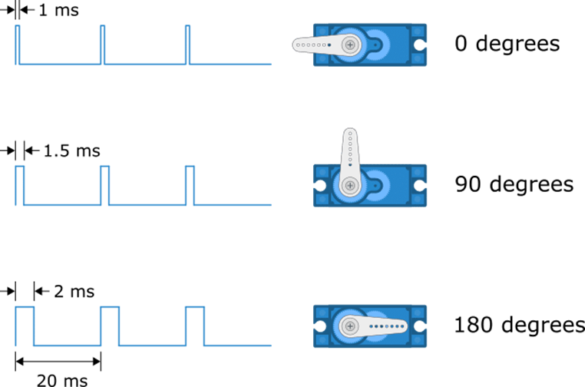
II. Sơ lược hệ thống.
6. Servo.
Servo SG90 được điều khiển bằng băm xung. Tùy thuộc vào duty cycle, mà servo quay góc khác nhau.

Slide 10
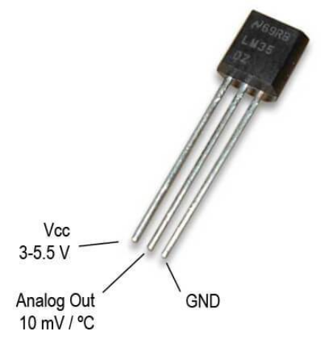
II. Sơ lược hệ thống.
7. LM35.
LM35 là một loại cảm biến nhiệt độ bán dẫn tương tự rất phổ biến và được ứng dụng rất nhiều trong thực tế hiện nay. Nhiệt độ được xác định bằng cách đo hiệu điện thế ngõ ra và không cần căn chỉnh.
Nhiệt độ thay đổi tuyến tính: 10mV/°C

Slide 11
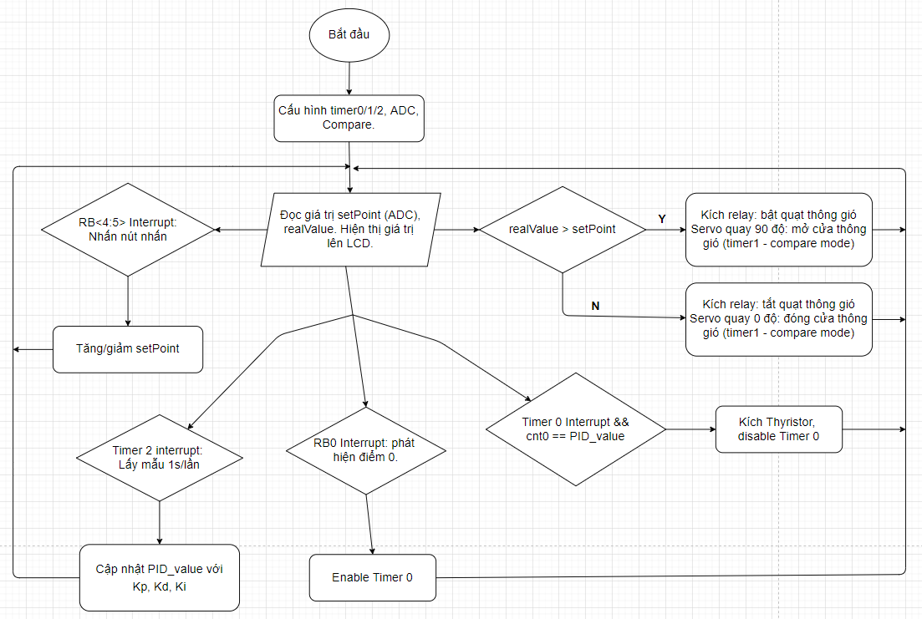
III. Chương trình.
1. Lưu đồ thuật toán tổng quát.

Slide 12
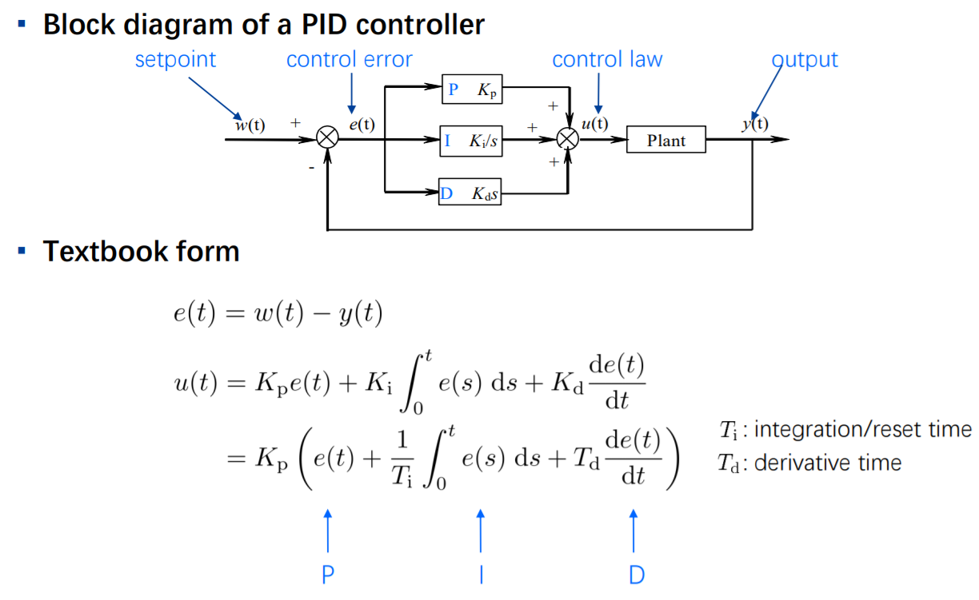
III. Chương trình.
2. Điều khiển gia nhiệt bằng PID.
a, PID tương tự.
*Trích từ slide của TS. Shanying Zhu – ĐH Giao thông Thượng Hải.

Slide 13
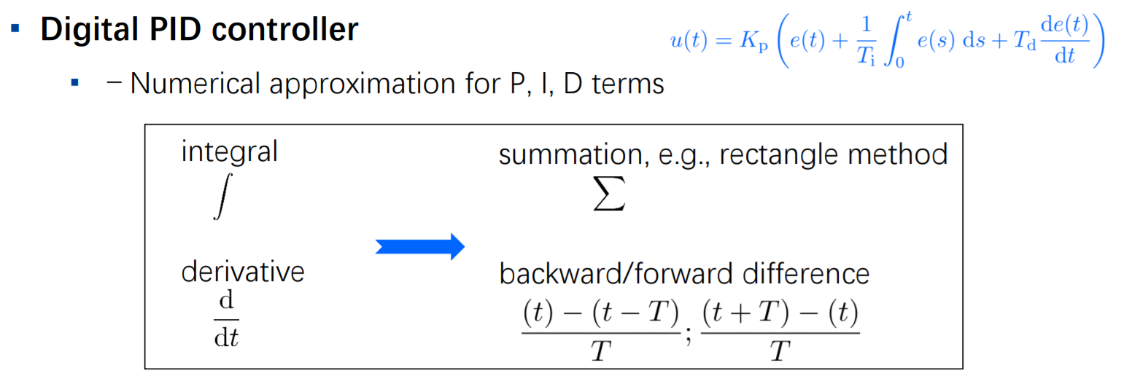
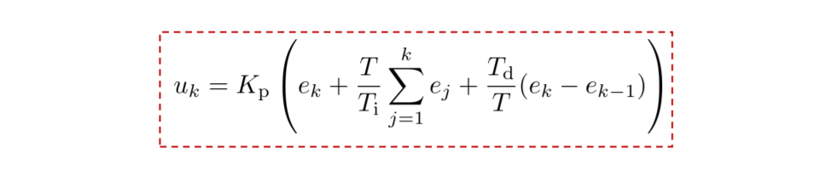
III. Chương trình.
2. Điều khiển gia nhiệt bằng PID.
a, PID số.
*Trích từ slide của TS. Shanying Zhu – ĐH Giao thông Thượng Hải.

Slide 14
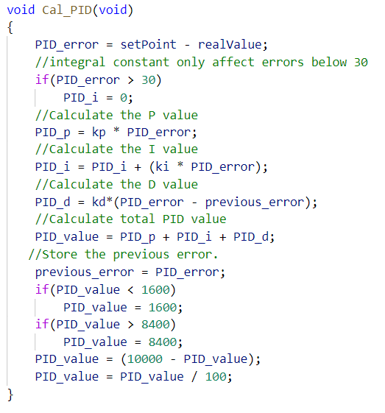
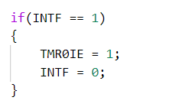
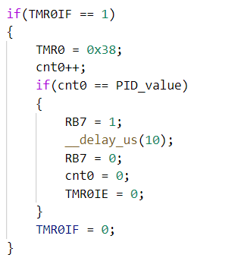
III. Chương trình.
2. Điều khiển gia nhiệt bằng PID.
c, Code.
2. Enable Timer 0 khi phát hiện điểm 0.
3. Timer 0 được cài đặt interrupt mỗi 100us. Khi cnt0 đạt giá trị bằng PID_value, kích Thyristor và Disable Timer 0
1. Tính lại giá trị PID sau mỗi 1s

Slide 15
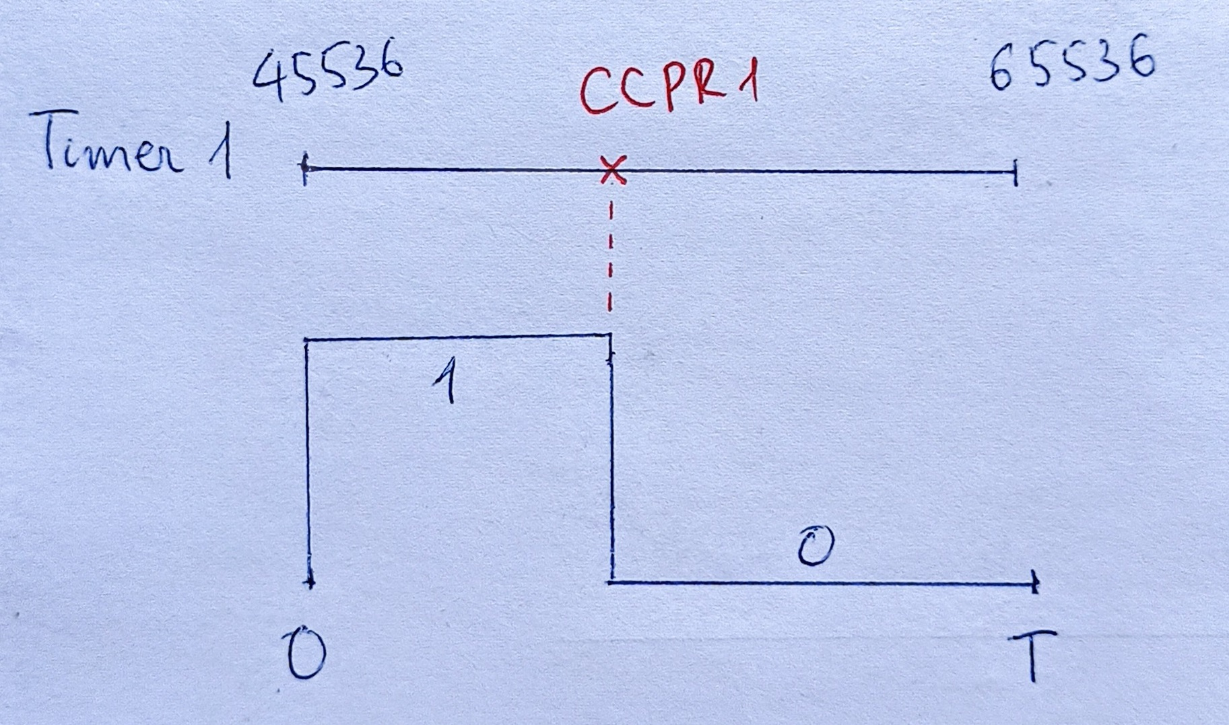
III. Chương trình.
3. Servo.
Đặt vấn đề
Với Tosc = 16MHz, PR2 = 255 (8bit), Timer2 prescale (max) = 16. Tpwm = 1ms << 20ms.
Cài đặt chu kỳ bằng Timer 1
SG90 có chu kỳ 20ms
Tần số thạch anh = 16MHz => Tần số PIC, f = 4MHz
Chọn prescale = 1:4
Chu kỳ cho 1 tick = 1/(f/4) = 1us
Cần tạo ra 20ms, ta cần 20000 tick
Đặt preload cho Timer 1 = 65536 – 20000 = 45536 (0xB1E6)
Điều chỉnh duty bằng compare mode.
Khi giá trị trên Timer 1 = CCP1R -> RC2 =0.
Servo quay góc 0 độ: CPP1R = 0xB430
Servo quay góc 90 độ: CCP1R = 0xB7A8

Slide 16
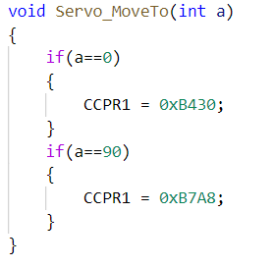
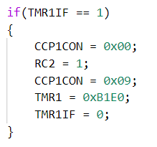
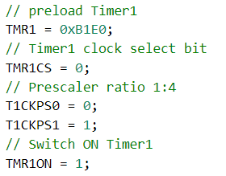
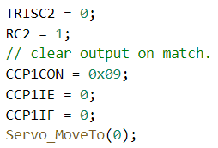
III. Chương trình.
3. Servo.
1. Cấu hình Timer 1
Tạo chu kỳ 20ms.
2. Cấu hình cho compare mode.
Xóa RC2 về 0 khi gí trị trên Timer 1 = CCPR1.
3. Điều chỉnh duty cycle.
4. Đặt RC2 lên 1, preload lại Timer 1, đặt lại chế độ compare khi kết thúc 1 chu kỳ (Timer 1 interrupt)

Slide 17
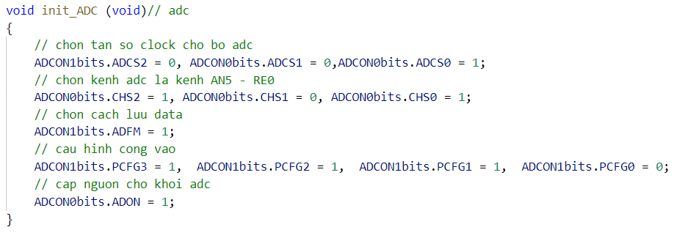
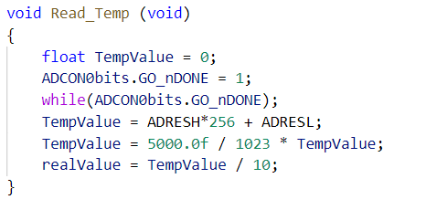
III. Chương trình.
4. ADC.
a, Cấu hình ADC.
b, Đọc nhiệt độ

Slide 18
IV. Tổng kết & đánh giá.
1. Ảnh thực tế.

Slide 19
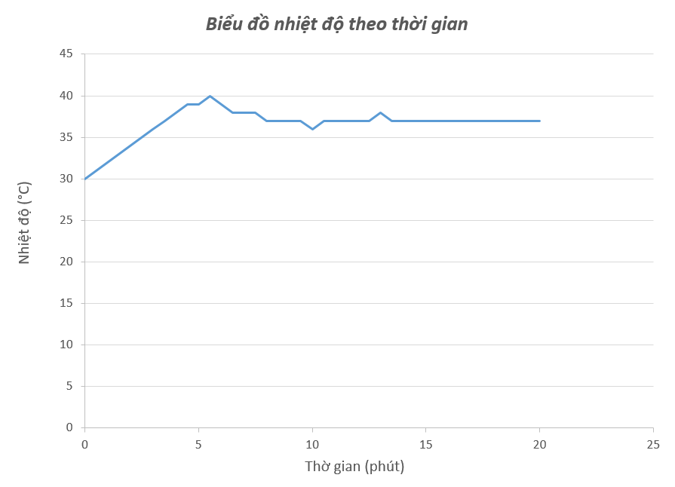
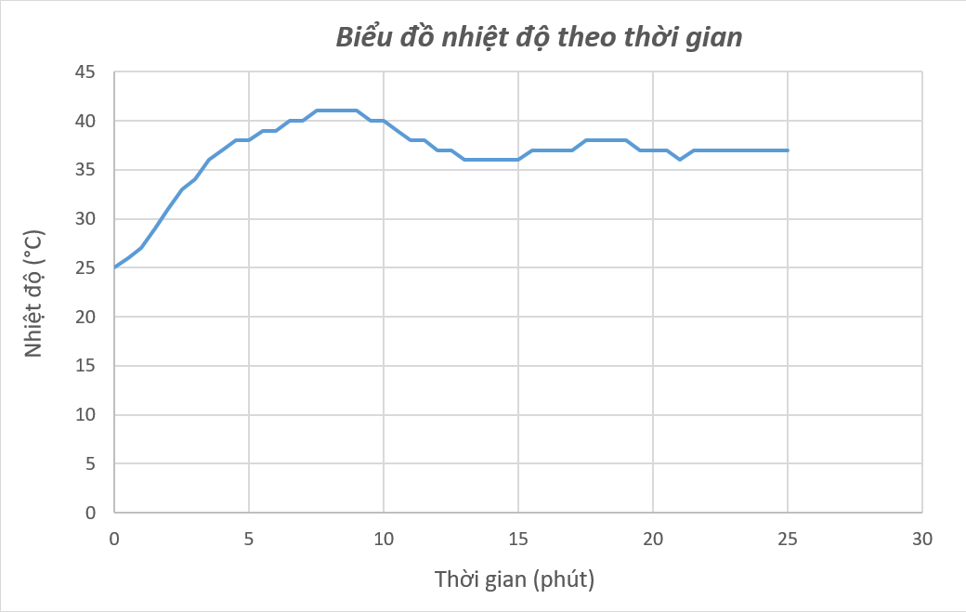
IV. Tổng kết & đánh giá.
2. Đáp ứng hệ thống.
Đáp ứng hệ thống với nhiệt độ cài đặt 37°C và nhiệt độ môi trường 30°C.
Đáp ứng hệ thống với nhiệt độ cài đặt 37°C nhiệt độ môi trường 25°C.

Slide 20
IV. Tổng kết & đánh giá.
3. Đánh giá.
Ưu điểm:
Hệ thộng hoạt động ổn định
Khả năng ổn định nhiệt độ tốt hơn so với phương pháp truyền thống (cắm bóng điện) và điều khiển on/off bằng relay.
Nhược điểm:
Cần thiết kế lại mạch để áp dụng trực tiế vào thực tiễn.
Cần khảo sát thêm giá trị PID để ổn định với khoảng chênh lệch nhiệt độ lớn hơn.

Slide 21
THANK YOU!
Github: https://github.com/KhanhNgo19/HK_Egg_Incubator

Slide 22
Light Bulb Infographics
Mercury
Venus
Saturn
Mars
Mercury is the smallest planet
Venus has a beautiful name
Saturn is the ringed one
Mars is actually a cold place

Slide 23
Light Bulb Infographics
It’s a gas giant and also the biggest planet in the Solar System
Saturn is the ringed one. It’s composed mostly of hydrogen and helium
It has a beautiful name, but it’s terribly hot, even more than Mercury
Mercury is the closest planet to the Sun and the smallest one
Mars is actually a cold place. It’s a planet full of iron oxide dust
Neptune is the farthest planet from the Sun and the fourth-largest

Slide 24
Light Bulb Infographics
Jupiter is a gas giant and actually also the biggest planet in the Solar System. It is the fourth-brightest object in the sky
1
Saturn is a gas giant in the Solar System, composed mostly of hydrogen and helium.
Yes, this is the ringed one
2
Venus has a beautiful name and is the second planet from the Sun. It’s terribly hot and its atmosphere is extremely poisonous
3

Slide 25
Light Bulb Infographics
Mercury is the smallest planet in the Solar System
01
Jupiter is the biggest planet in the Solar System
02
Saturn is composed mostly of hydrogen and helium
03
Mars is actually a cold place. It’s full of iron oxide dust
04

Slide 26
Light Bulb Infographics
It is the smallest planet in
the Solar System
Mercury
It is composed mostly of
hydrogen and helium
Saturn
It has a beautiful name,
but it is terribly hot
Venus
It is the biggest planet
in the Solar System
Jupiter
It is actually a cold place.
It’s full of iron oxide dust
Mars

Slide 27
Light Bulb Infographics
01
02
03
04
05
Jupiter is the biggest planet in the Solar System
Mercury is the closest planet
to the Sun
Venus has a beautiful name, also high temperatures
Saturn is composed mostly of hydrogen and helium
Despite being red, Mars is actually
a cold place

Slide 28
Light Bulb Infographics
Jupiter is the biggest planet in the Solar System
Saturn is composed mostly of hydrogen and helium
Venus has a beautiful name, also high temperatures
Despite being red, Mars is actually
a cold place

Slide 29
Light Bulb Infographics
Jupiter is a gas giant and the biggest planet in the Solar System. It’s the fourth-brightest object in the sky
Saturn is a gas giant in the Solar System, composed mostly of hydrogen and helium. Yes, It’s the ringed one
Venus has a beautiful name, but it’s terribly hot. It’s the second planet from the Sun in the Solar System

Slide 30
Light Bulb Infographics
01
Jupiter is a gas giant and also the biggest planet in the Solar System
It has a beautiful name, but it’s terribly hot, even hotter than Mercury
04
02
Mars is actually a cold place. It’s a planet full of iron oxide dust
03
It’s the smallest and closest planet to the Sun in the Solar System

Slide 31
Light Bulb Infographics
Saturn is a gas giant in the Solar System, composed of hydrogen and helium
Venus has a beautiful name, and is the second planet from the Sun
Despite being red, Mars is actually a cold place. It’s full of iron oxide dust
Jupiter is a gas giant and actually also the biggest planet in the Solar System

Slide 32
Light Bulb Infographics
It’s a gas giant and also the biggest planet in the Solar System
Saturn is the ringed one. It’s composed mostly of hydrogen and helium
It has a beautiful name, but it’s terribly hot, even more than Mercury
Mercury is the closest planet to the Sun and the smallest one
Mars is actually a cold place. It’s a planet full of iron oxide dust
It has a beautiful name and is the second planet from the Sun

Slide 33
Light Bulb Infographics
Mercury is the closest planet to the Sun and the smallest one
Saturn is composed of hydrogen and helium. It’s the ringed one
Venus has the most beautiful name and is the second planet
Mars is actually a cold place. It’s a planet full of iron oxide dust

Slide 34
Light Bulb Infographics
Mercury is the smallest planet in the Solar System
Mercury is the smallest planet in the Solar System
Saturn is a gas giant and has several rings
Saturn is a gas giant and has several rings
Venus has the most beautiful name
Venus has the most beautiful name

Slide 35
Light Bulb Infographics
Jupiter is the biggest planet in the Solar System
Venus has a beautiful name,
but it’s terribly hot
Mercury is the smallest planet in the Solar System
Saturn is composed of
hydrogen and helium

Slide 36
Light Bulb Infographics
Mercury
Venus
Mercury is the closest planet to the Sun and smallest one
Venus has a beautiful name and is the second planet from the Sun
Jupiter
Mars
Jupiter is a gas giant. It’s the biggest planet in the Solar System
Mars is actually a cold place. This planet is full of iron oxide dust

Slide 37
Light Bulb Infographics
Jupiter
Jupiter is the biggest planet in the Solar System
Mercury
Mercury is the smallest planet in the Solar System
Neptune
Neptune is the farthest planet from the Sun

Slide 38
Light Bulb Infographics
1
Jupiter is a gas giant and also the biggest planet in the Solar System
2
Saturn is a gas giant and composed mostly of hydrogen and helium
3
Venus has a beautiful name and is the second planet from the Sun
4
Despite being red, Mars is actually a cold place. It’s full of iron oxide dust

Slide 39
Light Bulb Infographics
Mercury is the closest planet to the Sun and the smallest one in the Solar System
Despite being red, Mars is actually a cold place. It’s full of iron oxide dust
Saturn is the ringed one. It’s composed of hydrogen and helium
Jupiter is a gas giant and the biggest planet in the Solar System
It has a beautiful name and is the second planet from the Sun

Slide 40
Light Bulb Infographics
Despite being red, Mars is a cold place. It’s full of iron oxide dust, giving the planet its reddish cast
Venus has a beautiful name, but it’s terribly hot and its atmosphere is poisonous
Mercury is the closest planet to the Sun and the smallest one in the Solar System
Saturn is a gas giant and ringed one and it is composed mostly of hydrogen and helium
Jupiter is a gas giant and the fourth-brightest object in the night sky

Slide 41
Light Bulb Infographics
Mercury is the smallest planet
Neptune is the farthest planet
Saturn has several rings
Jupiter is the biggest planet
Venus has a beautiful name
Mars is actually
a cold place
Earth is where we live on

Slide 42
Light Bulb Infographics
Mercury is the closest to the Sun
Jupiter is the biggest planet
Neptune is the farthest planet

Slide 43
Light Bulb Infographics
1
2
3
Jupiter is the biggest planet in the Solar System
Mercury is the closest planet
to the Sun
Venus has a beautiful name, also high temperatures

Slide 44
Light Bulb Infographics
Jupiter is a gas giant and actually also the biggest planet in the Solar System
Despite being red, Mars is actually a cold place. It’s full of iron oxide
Saturn is a gas giant in the Solar System, composed of hydrogen and helium
Venus has a beautiful name, but it’s the hottest planet in the Solar System

Slide 45
Light Bulb Infographics
Saturn is the ringed one. It’s composed mostly
of hydrogen and helium
It’s a gas giant and also the biggest
planet in the Solar System
It has a beautiful name, but it’s
terribly hot, even more than Mercury
Mars is actually a cold place.
It’s a planet full of iron oxide dust
It’s the smallest and closest
planet to the Sun in the Solar System

Slide 46
Light Bulb Infographics
It’s the smallest planet in the Solar System
It’s composed mostly of hydrogen and helium
It’s the biggest planet in the Solar System
Neptune is the farthest planet from the Sun
Venus has a very poisonous atmosphere
It’s a cold place. It’s full of iron oxide dust

Slide 47
Light Bulb Infographics
It’s the cutest and smallest planet in
the Solar System
It’s a gas giant. It’s composed mostly of hydrogen and helium
Venus has a beautiful name, but also very high temperatures
It is the biggest and most wonderful planet of them all

Slide 48
Light Bulb Infographics
1
Venus has a beautiful name, but it’s the hottest and the second planet in the Solar System
2
Jupiter it’s a gas giant and also the biggest and the most wonderful planet in the Solar System
3
Saturn is a gas giant, the ringed one and a wonderful planet. It’s composed mostly of hydrogen and helium
4
Mercury is the closest planet to the Sun and the smallest one in the Solar System

Slide 49
Light Bulb Infographics
It’s a gas giant and also the biggest planet in the Solar System
Mars is actually a cold place. It’s a planet full of iron oxide dust
It has a beautiful name, but it’s terribly hot, even more than Mercury
Saturn is the ringed one. It’s composed mostly of hydrogen and helium

Slide 50
Instructions for use (free users)
In order to use this template, you must credit Slidesgo by keeping the Thanks slide.
You are allowed to:
Modify this template.
Use it for both personal and commercial purposes.
You are not allowed to:
Sublicense, sell or rent any of Slidesgo Content (or a modified version of Slidesgo Content).
Distribute this Slidesgo Template (or a modified version of this Slidesgo Template) or include it in a database or in any other product or service that offers downloadable images, icons or presentations that may be subject to distribution or resale.
Use any of the elements that are part of this Slidesgo Template in an isolated and separated way from this Template.
Delete the “Thanks” or “Credits” slide.
Register any of the elements that are part of this template as a trademark or logo, or register it as a work in an intellectual property registry or similar.
For more information about editing slides, please read our FAQs or visit Slidesgo School:
https://slidesgo.com/faqs and https://slidesgo.com/slidesgo-school

Slide 51
Instructions for use (premium users)
In order to use this template, you must be a Premium user on Slidesgo.
You are allowed to:
Modify this template.
Use it for both personal and commercial purposes.
Hide or delete the “Thanks” slide and the mention to Slidesgo in the credits.
Share this template in an editable format with people who are not part of your team.
You are not allowed to:
Sublicense, sell or rent this Slidesgo Template (or a modified version of this Slidesgo Template).
Distribute this Slidesgo Template (or a modified version of this Slidesgo Template) or include it in a database or in any other product or service that offers downloadable images, icons or presentations that may be subject to distribution or resale.
Use any of the elements that are part of this Slidesgo Template in an isolated and separated way from this Template.
Register any of the elements that are part of this template as a trademark or logo, or register it as a work in an intellectual property registry or similar.
For more information about editing slides, please read our FAQs or visit Slidesgo School:
https://slidesgo.com/faqs and https://slidesgo.com/slidesgo-school

Slide 52
Infographics
You can add and edit some infographics to your presentation to present your data in a visual way.
Choose your favourite infographic and insert it in your presentation using Ctrl C + Ctrl V or Cmd C + Cmd V in Mac.
Select one of the parts and ungroup it by right-clicking and choosing “Ungroup”.
Change the color by clicking on the paint bucket.
Then resize the element by clicking and dragging one of the square-shaped points of its bounding box (the cursor should look like a double-headed arrow). Remember to hold Shift while dragging to keep the proportions.
Group the elements again by selecting them, right-clicking and choosing “Group”.
Repeat the steps above with the other parts and when you’re done editing, copy the end result and paste it into your presentation.
Remember to choose the “Keep source formatting” option so that it keeps the design. For more info, please visit Slidesgo School.

